Slide 1
Getting started with GeoSPARQL
LD Cursus
Bart De Lathouwer (Geonovum), Dave Kolas, Matt Perry & John Herring (Oracle) Thimo Thoeye (City of Ghent)
8 april 2025
Openbaar

Slide 2
Introduction to GeoSPARQL
GeoSPARQL Vocabulary
GeoSPARQL Query Relations
Worked Example:
Ontology
Instance data
Query
Conclusion

Slide 3
Purpose of GeoSPARQL
Many problems for which semantic solutions are relevant have an inherent geospatial context
Which hospitals within 20 miles have appropriate treatment centers for my patient?
What airports within 50 miles of a mission objective can support a C5?
In order to efficiently perform geospatial reasoning, special indexing is required
We cannot take away the ability to do semantic reasoning though

Slide 4
Scope
GeoSPARQL is a minimal RDF/OWL/SPARQL vocabulary for storage and query of geospatial information
Should be able to be easily attached to ontologies with a need for spatial information
Represents *only* geometries and the concept of a Feature (a thing with a geometry) and the geospatial relationships between them
Result: triple store implementations can spatially index information in the vocabulary, and perform spatial reasoning
GeoSPARQL intends to be
Robust enough to be used for ‘serious’ geospatial data
Simple enough for Linked Open Data

Slide 5
SPARQL
W3C Recommendation for querying RDF/OWL
Syntax based on RDF/Turtle
PREFIX dc: <http://purl.org/dc/elements/1.1/>
PREFIX ns: <http://example.org/ns#>
SELECT ?title ?price WHERE {
?x dc:title ?title .
OPTIONAL {
?x ns:price ?price .
FILTER (?price < 30)
}
}

Slide 6
SPARQL
W3C Recommendation for querying RDF/OWL
Syntax based on RDF/Turtle
PREFIX dc: <http://purl.org/dc/elements/1.1/>
PREFIX ns: <http://example.org/ns#>
SELECT ?title ?price WHERE {
?x dc:title ?title .
OPTIONAL {
?x ns:price ?price .
FILTER (?price < 30)
}
}

Slide 7
Turtle - Terse RDF Triple Language
Simple triples are a sequence of subject, predicate, object terms, separated by whitespace and terminated by '.' after each triple
IRIs are written enclosed in '<' and '>’
URIs may also be abbreviated by using Turtle’s @prefix directive that allows declaring a short prefix name for a long prefix of repeated URIs.

Slide 8
Turtle - Terse RDF Triple Language
Simple triples are a sequence of subject, predicate, object terms, separated by whitespace and terminated by '.' after each triple
IRIs are written enclosed in '<' and '>’
URIs may also be abbreviated by using Turtle’s @prefix directive that allows declaring a short prefix name for a long prefix of repeated URIs.

Slide 9
Turtle - Terse RDF Triple Language
The , symbol may be used to repeat the subject and predicate of triples that only differ in the object RDF term.
:a :b :c , :d .
:a :b :c . :a :b :d .
The ; symbol may be used to repeat the subject of triples
:a :b :c ; :d :e .
:a :b :c . :a :d :e .

Slide 10
Turtle - Terse RDF Triple Language
The , symbol may be used to repeat the subject and predicate of triples that only differ in the object RDF term.
:a :b :c , :d .
:a :b :c . :a :b :d .
The ; symbol may be used to repeat the subject of triples
:a :b :c ; :d :e .
:a :b :c . :a :d :e .

Slide 11
OGC GeoSPARQL
Uses W3C’s SPARQL’s extensibility framework
Contains a shared vocabulary
Feature Model and Geometry Model
Minimal set of classes and properties supporting triple patterns
Contains datatypes based on text-based geometry serializations : WKT (augmented for CRS); GML
geo:wktLiteral, geo:gmlLiteral, ...
Different conformance class for each serialization
Contains shared set of FILTER functions
For each Simple Features function
Contains Query Rewrite Rules for spatial relations between Features — both explicit (triples) and implicit (geometry)

Slide 12
GeoSPARQL vs W3C Geo
Unlike GeoSPARQL, W3C Geo:
Only supports point geometries
Only supports one coordinate reference system
Has no spatial relationships
Have data in W3C Geo format?
No problem. One query converts W3C Geo into GeoSPARQL information (see paper “Enabling the Geospatial Semantic Web with Parliament and GeoSPARQL”)
W3C Geo is very simple and useful, but GeoSPARQL offers significantly more functionality

Slide 13
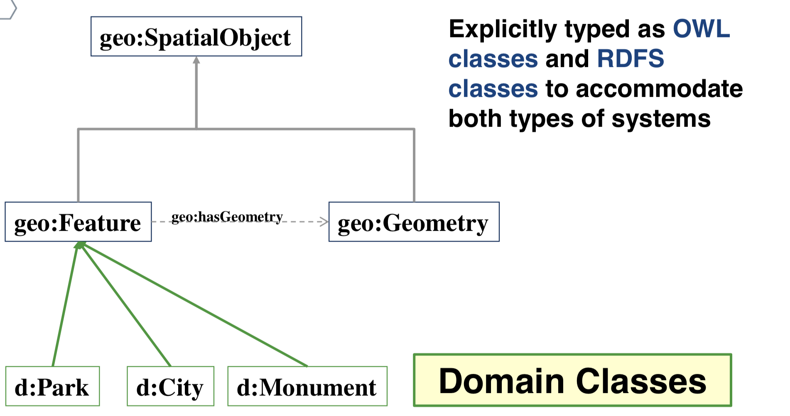
Ontology - Basic Classes

Slide 14
Datatype Properties for geo:Geometry
Explicitly typed as owl:DatatypeProperty and rdf:Property
geo:dimension
geo:coordinateDimension
geo:spatialDimension
geo:isEmpty
geo:isSimple
geo:is3D
geo:asWKT
geo:asGML

Slide 15
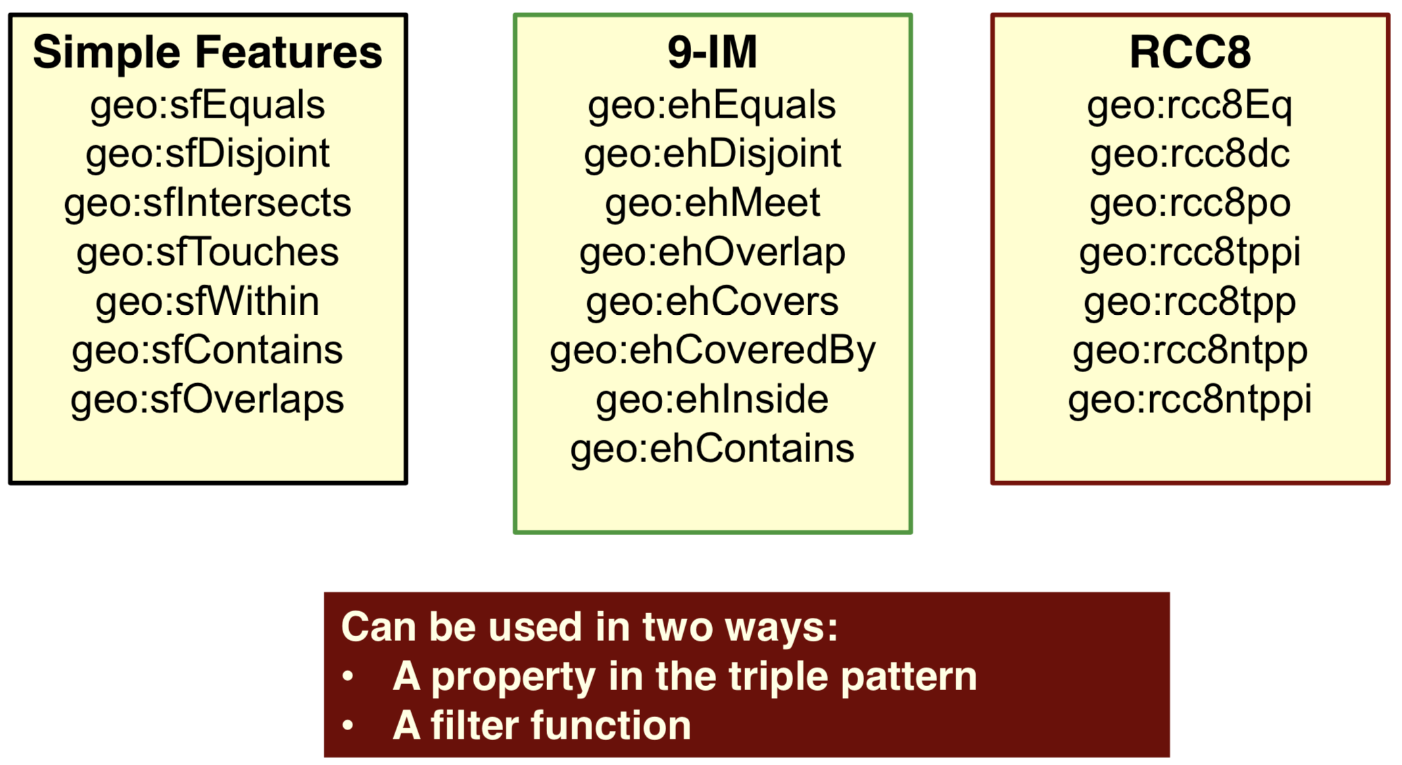
Topological Spatial Relations

Slide 16
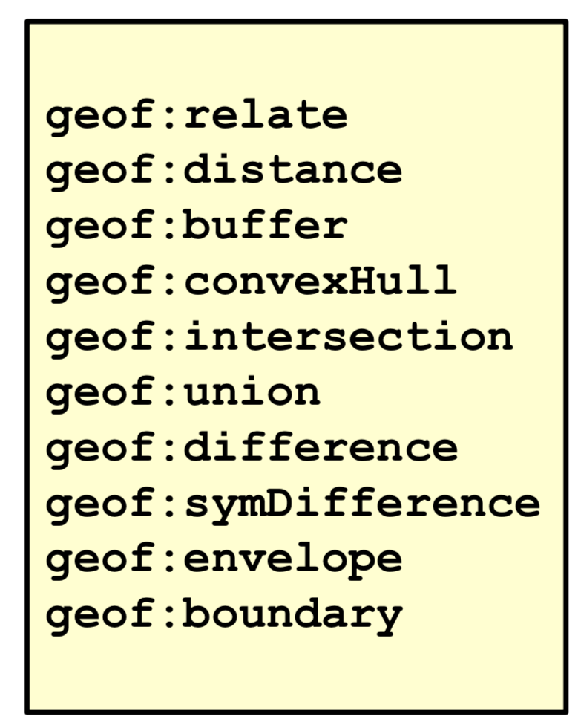
Transformational FILTER Functions

Slide 17
Implementations
BBN Parliament
http://parliament.semwebcentral.org/ – Open Source triplestore
Jena/Joseki front end
Oracle Database
http://www.oracle.com/technetwork/database/index.html
Strabon
http://www.strabon.di.uoa.gr/about
Triply
...

Slide 18
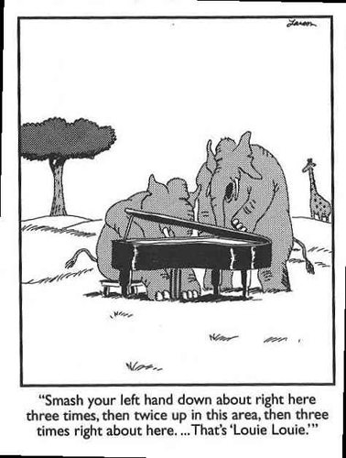
Ready to do it yourself?

Slide 19
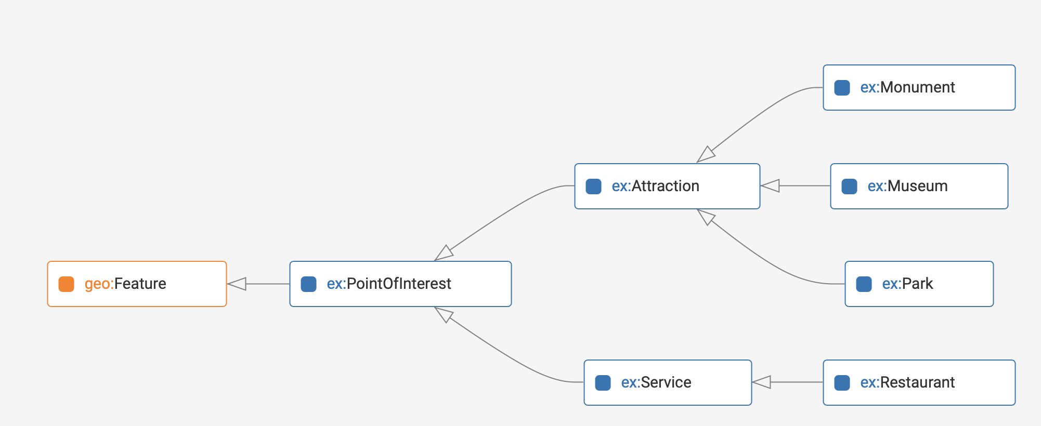
Example Ontology

Slide 20
Example Ontology (in Turtle)
@prefix owl: <http://www.w3.org/2002/07/owl#> .
@prefix rdfs: <http://www.w3.org/2000/01/rdf-schema#> .
@prefix geo: <http://www.opengis.net/ont/geosparql#> .
@prefix ex: <http://www.example.org/POI#> .
ex:Restaurant a owl:Class;
rdfs:subClassOf ex:Service .
ex:Park a owl:Class;
rdfs:subClassOf ex:Attraction .
ex:Museum a owl:Class;
rdfs:subClassOf ex:Attraction .
ex:Monument a owl:Class;
rdfs:subClassOf ex:Attraction .
ex:Service a owl:Class;
rdfs:subClassOf ex:PointOfInterest .
ex:Attraction a owl:Class;
rdfs:subClassOf ex:PointOfInterest .
ex:PointOfInterest a owl:Class;
rdfs:subClassOf geo:Feature .

Slide 21
Example Ontology
@prefix owl: <http://www.w3.org/2002/07/owl#> .
@prefix rdfs: <http://www.w3.org/2000/01/rdf-schema#> .
@prefix geo: <http://www.opengis.net/ont/geosparql#> .
@prefix ex: <http://www.example.org/POI#> .
ex:Restaurant a owl:Class;
rdfs:subClassOf ex:Service .
ex:Park a owl:Class;
rdfs:subClassOf ex:Attraction .
ex:Museum a owl:Class;
rdfs:subClassOf ex:Attraction .
ex:Monument a owl:Class;
rdfs:subClassOf ex:Attraction .
ex:Service a owl:Class;
rdfs:subClassOf ex:PointOfInterest .
ex:Attraction a owl:Class;
rdfs:subClassOf ex:PointOfInterest .
ex:PointOfInterest a owl:Class;
rdfs:subClassOf geo:Feature .

Slide 22
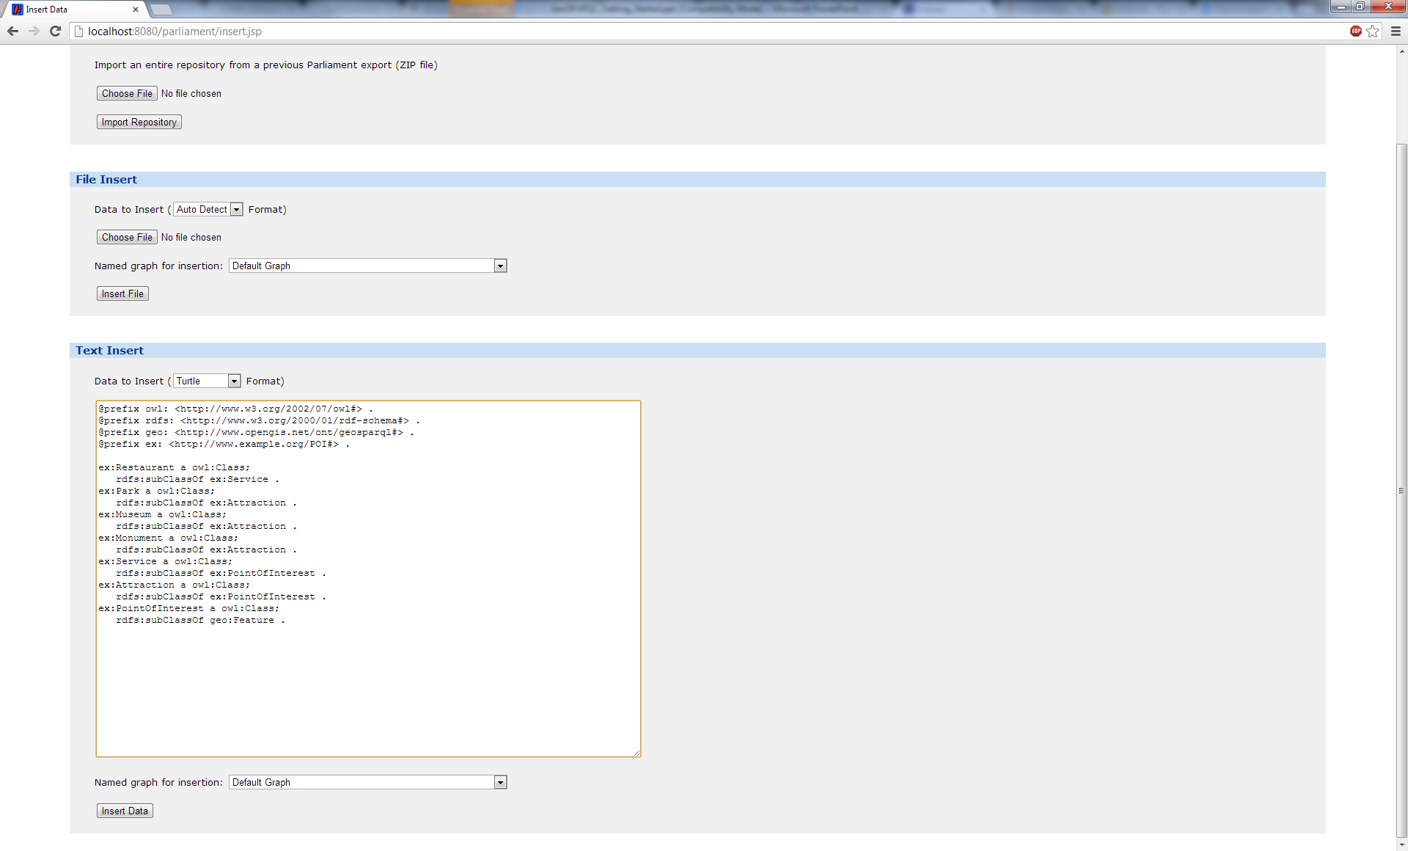
Inserting into Parliament

Slide 23
In JSON-LD
[{"@id":"http://www.example.org/POI#Attraction","@type":["http://www.w3.org/2002/07/owl#Class"],"http://www.w3.org/2000/01/rdf-schema#subClassOf":[{"@id":"http://www.example.org/POI#PointOfInterest"}]},{"@id":"http://www.example.org/POI#Monument","@type":["http://www.w3.org/2002/07/owl#Class"],"http://www.w3.org/2000/01/rdf-schema#subClassOf":[{"@id":"http://www.example.org/POI#Attraction"}]},{"@id":"http://www.example.org/POI#Museum","@type":["http://www.w3.org/2002/07/owl#Class"],"http://www.w3.org/2000/01/rdf-schema#subClassOf":[{"@id":"http://www.example.org/POI#Attraction"}]},{"@id":"http://www.example.org/POI#Park","@type":["http://www.w3.org/2002/07/owl#Class"],"http://www.w3.org/2000/01/rdf-schema#subClassOf":[{"@id":"http://www.example.org/POI#Attraction"}]},{"@id":"http://www.example.org/POI#PointOfInterest","@type":["http://www.w3.org/2002/07/owl#Class"],"http://www.w3.org/2000/01/rdf-schema#subClassOf":[{"@id":"http://www.opengis.net/ont/geosparql#Feature"}]},{"@id":"http://www.example.org/POI#Restaurant","@type":["http://www.w3.org/2002/07/owl#Class"],"http://www.w3.org/2000/01/rdf-schema#subClassOf":[{"@id":"http://www.example.org/POI#Service"}]},{"@id":"http://www.example.org/POI#Service","@type":["http://www.w3.org/2002/07/owl#Class"],"http://www.w3.org/2000/01/rdf-schema#subClassOf":[{"@id":"http://www.example.org/POI#PointOfInterest"}]},{"@id":"http://www.opengis.net/ont/geosparql#Feature"},{"@id":"http://www.w3.org/2002/07/owl#Class"}]

Slide 24
In Notation3
@prefix owl: <http://www.w3.org/2002/07/owl#> .
@prefix rdfs: <http://www.w3.org/2000/01/rdf-schema#> .
<http://www.example.org/POI#Restaurant>
a owl:Class ;
rdfs:subClassOf <http://www.example.org/POI#Service> .
<http://www.example.org/POI#Park>
a owl:Class ;
rdfs:subClassOf <http://www.example.org/POI#Attraction> . <http://www.example.org/POI#Museum> a owl:Class ; rdfs:subClassOf <http://www.example.org/POI#Attraction> . <http://www.example.org/POI#Monument> a owl:Class ; rdfs:subClassOf <http://www.example.org/POI#Attraction> . <http://www.example.org/POI#Service> a owl:Class ; rdfs:subClassOf <http://www.example.org/POI#PointOfInterest> . <http://www.example.org/POI#Attraction> a owl:Class ; rdfs:subClassOf <http://www.example.org/POI#PointOfInterest> . <http://www.example.org/POI#PointOfInterest> a owl:Class ; rdfs:subClassOf <http://www.opengis.net/ont/geosparql#Feature> .

Slide 25
Graph

Slide 26
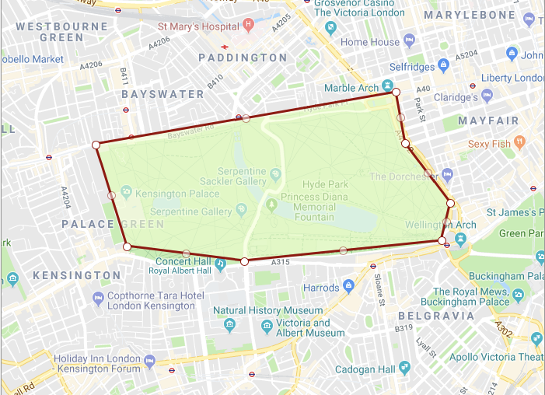
Hyde Park – Speaker Corner - NHM

Slide 27
Example Instance data
@prefix owl: <http://www.w3.org/2002/07/owl#> .
@prefix rdfs: <http://www.w3.org/2000/01/rdf-schema#> .
@prefix geo: <http://www.opengis.net/ont/geosparql#> .
@prefix ex: <http://www.example.org/POI#> .
@prefix sf: <http://www.opengis.net/ont/sf#> .
ex:SpeakersCorner a ex:Monument ;
rdfs:label "Speakers Corner" ;
geo:hasGeometry ex:SCPoint .
ex:SCPoint a sf:Point ;
geo:asWKT "POINT(-0.15936 51.5119)"^^sf:wktLiteral .
<http://dbpedia.org/page/Natural_History_Museum,_London> a ex:Museum ;
rdfs:label "Natural History Museum" ;
geo:hasGeometry ex:NHMPoint .
ex:NHMPoint a sf:Point ;
geo:asWKT "POINT(-0.1765 51.4964)"^^sf:wktLiteral .
Notes:
Delete entire graph: DELETE WHERE { ?x ?y ?z }
<http://www.opengis.net/def/crs/OGC/1.3/CRS84>

Slide 28
Example Instance data
@prefix owl: <http://www.w3.org/2002/07/owl#> .
@prefix rdfs: <http://www.w3.org/2000/01/rdf-schema#> .
@prefix geo: <http://www.opengis.net/ont/geosparql#> .
@prefix ex: <http://www.example.org/POI#> .
@prefix sf: <http://www.opengis.net/ont/sf#> .
ex:SpeakersCorner a ex:Monument ;
rdfs:label "Speakers Corner" ;
geo:hasGeometry ex:SCPoint .
ex:SCPoint a sf:Point ;
geo:asWKT "POINT(-0.15936 51.5119)"^^sf:wktLiteral .
<http://dbpedia.org/page/Natural_History_Museum,_London> a ex:Museum ;
rdfs:label "Natural History Museum" ;
geo:hasGeometry ex:NHMPoint .
ex:NHMPoint a sf:Point ;
geo:asWKT "POINT(-0.1765 51.4964)"^^sf:wktLiteral .
Notes:
Delete entire graph: DELETE WHERE { ?x ?y ?z }
<http://www.opengis.net/def/crs/OGC/1.3/CRS84>

Slide 29
Example Instance data
@prefix owl: <http://www.w3.org/2002/07/owl#> .
@prefix rdfs: <http://www.w3.org/2000/01/rdf-schema#> .
@prefix geo: <http://www.opengis.net/ont/geosparql#> .
@prefix ex: <http://www.example.org/POI#> .
@prefix sf: <http://www.opengis.net/ont/sf#> .
ex:HydePark a ex:Park ;
rdfs:label "Hyde Park" ;
geo:hasGeometry ex:HPPoly .
ex:HPPoly a sf:Polygon ;
geo:asWKT "POLYGON((-0.1912 51.51,-0.158 51.5136,-0.157 51.5101,-0.152 51.506,-0.153 51.5034,-0.17475 51.502,-0.1877 51.503,-0.1912 51.51))"^^sf:wktLiteral .
Notes:
Delete entire graph: DELETE WHERE { ?x ?y ?z }
<http://www.opengis.net/def/crs/OGC/1.3/CRS84>
<http://dbpedia.org/page/Hyde_Park>

Slide 30
Example Query
Which monuments are spatially within which parks?
prefix geo: <http://www.opengis.net/ont/geosparql#>
prefix geof: <http://www.opengis.net/def/functions/geosparql/>
prefix sf: <http://www.opengis.net/ont/sf#>
prefix ex: <http://www.example.org/POI#>
select ?m ?p ?mgeo ?pgeo
where {
?m a ex:Monument;
geo:hasGeometry/geo:asWKT ?mgeo.
?p a ex:Park;
geo:hasGeometry/geo:asWKT ?pgeo.
filter(geof:sfWithin(?mgeo, ?pgeo))
}

Slide 31
Example Instance data
@prefix owl: <http://www.w3.org/2002/07/owl#> .
@prefix rdfs: <http://www.w3.org/2000/01/rdf-schema#> .
@prefix geo: <http://www.opengis.net/ont/geosparql#> .
@prefix ex: <http://www.example.org/POI#> .
@prefix sf: <http://www.opengis.net/ont/sf#> .
ex:HydePark a ex:Park .
<http://dbpedia.org/page/Hyde_Park> a ex:Park ;
rdfs:label "Hyde Park" ;
geo:hasGeometry ex:HPPoly .
ex:HPPoly a sf:Polygon ;
geo:asWKT "POLYGON((-0.1912 51.51,-0.158 51.5136,-0.157 51.5101,-0.152 51.506,-0.153 51.5034,-0.17475 51.502,-0.1877 51.503,-0.1912 51.51))"^^sf:wktLiteral .
Notes:
Delete entire graph: DELETE WHERE { ?x ?y ?z }
<http://www.opengis.net/def/crs/OGC/1.3/CRS84>
<http://dbpedia.org/page/Hyde_Park>

Slide 32
Example Query
Which monuments are spatially within which parks?
prefix geo: <http://www.opengis.net/ont/geosparql#>
prefix geof: <http://www.opengis.net/def/functions/geosparql/>
prefix sf: <http://www.opengis.net/ont/sf#>
prefix ex: <http://www.example.org/POI#>
select ?m ?p ?mgeo ?pgeo
where {
?m a ex:Monument;
geo:hasGeometry/geo:asWKT ?mgeo.
?p a ex:Park;
geo:hasGeometry/geo:asWKT ?pgeo.
filter(geof:sfWithin(?mgeo, ?pgeo))
}

Slide 33
Example Query
Which monuments are spatially within which parks?
prefix geo: <http://www.opengis.net/ont/geosparql#>
prefix geof: <http://www.opengis.net/def/functions/geosparql/>
prefix sf: <http://www.opengis.net/ont/sf#>
prefix ex: <http://www.example.org/POI#>
select ?m ?p ?mgeo ?pgeo
where {
?m a ex:Monument;
geo:hasGeometry/geo:asWKT ?mgeo.
?p a ex:Park;
geo:hasGeometry/geo:asWKT ?pgeo.
filter(geof:sfWithin(?mgeo, ?pgeo))
}

Slide 34
Tip of the Iceberg
This is the simplest of simple examples
GeoSPARQL is about adding geospatial reasoning to Semantic Web applications
Most domain ontologies are much richer than this example, enabling interesting reasoning
Data integration applications can have a geospatial component
Some potential queries:
Which hospitals within 20 miles have appropriate treatment centers for my patient? (reasoning)
What hotels with 3 star ratings are within 10km of at least 3 attractions with 4 star ratings? (data integration)

Slide 35
Searching DBpedia
PREFIX dbo: <http://dbpedia.org/ontology/>
PREFIX dbp: <http://dbpedia.org/resource/>
PREFIX foaf: <http://xmlns.com/foaf/0.1/>
SELECT ?name ?bandname where {
?person foaf:name ?name .
?band dbo:bandMember ?person .
?band dbo:genre dbp:Techno .
?band foaf:name ?bandname .
}
http://dbpedia.org/sparql
Notes:
https://en.wikipedia.org/wiki/Praga_Khan

Slide 36
more
http://rdf.myexperiment.org/howtosparql
https://forge.taotesting.com/attachments/download/563/dbpedia-sparql-examples.pdf

Slide 37
Concluding
Triples
Easier to connect multiple database
But… we need to agree on the vocabularies and ontologies
Don’t create your own vocabularies and ontologies!!
Publishing geo data on the web
Foundation for the sematic web

